Slide 1


Slide 2
Project
PRESENTATION

Slide 3

“Connect & Converse”: A Web-based Interactive Discussion Hub for University Students

Slide 4
Group Members Introduction
Rubina (BC210400604)

Slide 5

INTRODUCTION OF PROJECT
Connect & Converse" is a web-based platform designed to facilitate interactive discussions and knowledge sharing among university students. This project aims to create an engaging online community where students can ask questions, share ideas, and participate in discussions on various topics related to academics, campus life, and general interests. Developed using PHP and a suitable web framework, the platform will prioritize a user-friendly experience, encouraging active communication and collaboration. Through this project, students will gain skills in web development, user experience design, and community management, fostering a supportive and vibrant student network

Slide 6
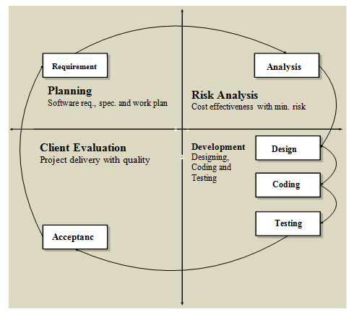
VU Process Model

Slide 7
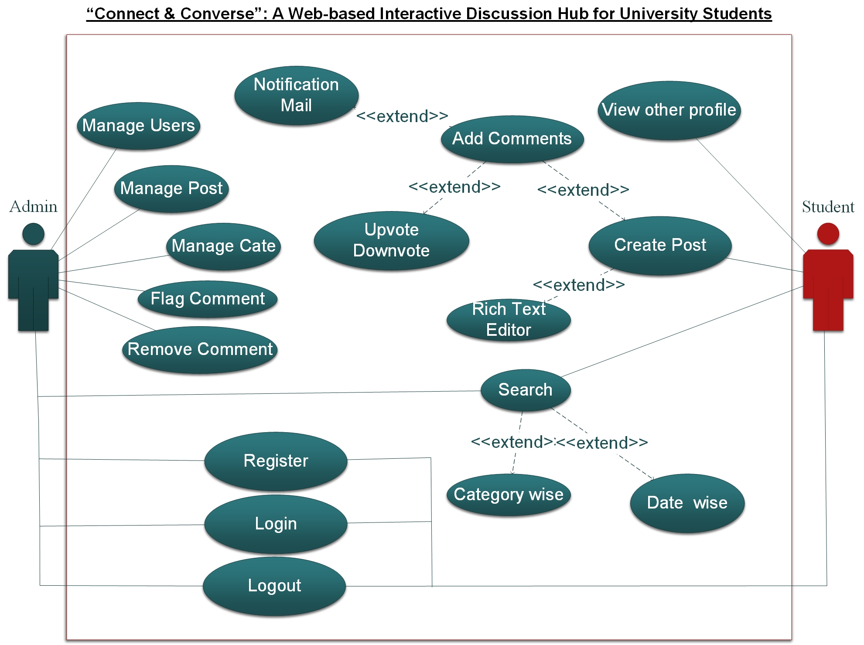
Use Case Diagram

Slide 8
Functional Requirements
User Registration & Login
Book Listings
Search & Filter Books
Request Book Exchange
Book Exchange Status
Messaging System
Book Reviews & Ratings
Book Wish List

Slide 9
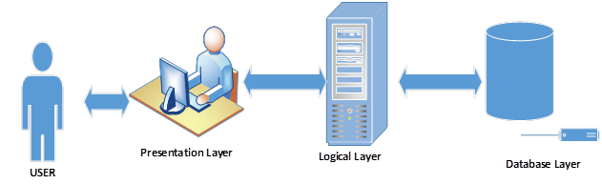
Architectural Design

Slide 10
Team Structure
Supervisor Saeed Amjad
Member Rubina

Slide 11
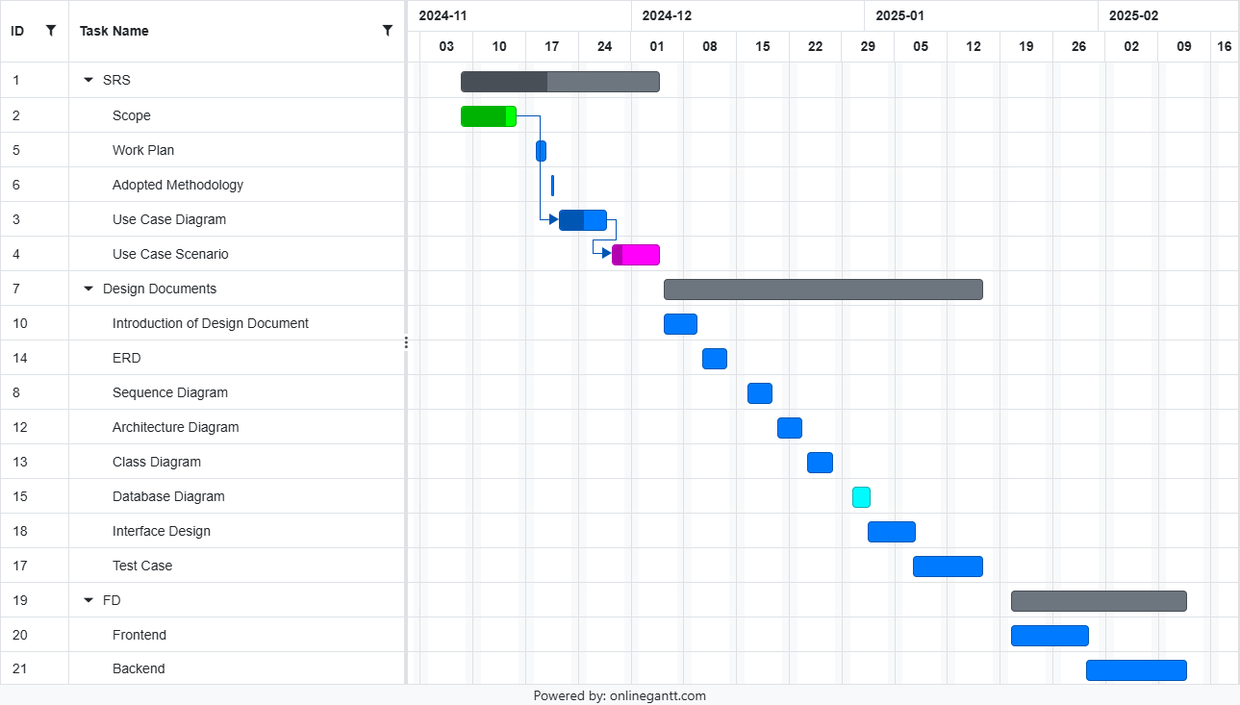
Project Schedule

Slide 12
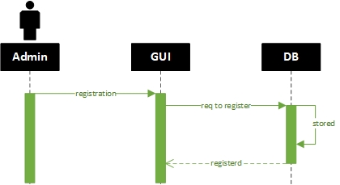
Sequence Diagrams
Admin Register
.

Slide 13
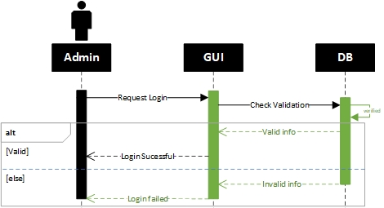
Sequence Diagrams
Admin Login
.

Slide 14
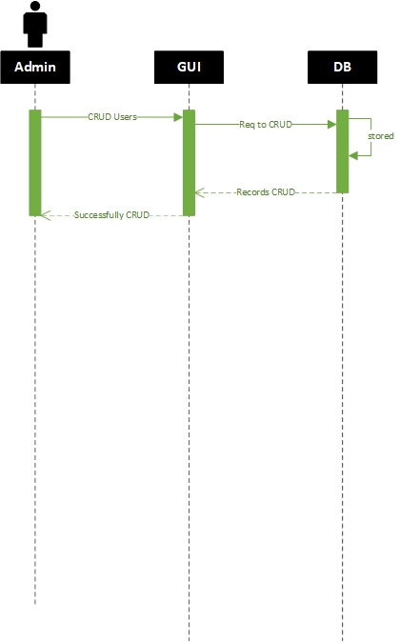
Sequence Diagrams
Admin CRUD Operations
.

Slide 15
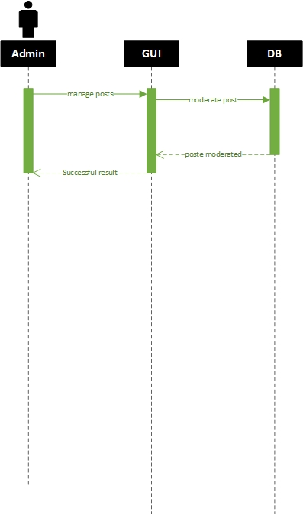
Sequence Diagrams
Admin Manage Post
.

Slide 16

Sequence Diagrams
Admin Flag Comments
.

Slide 17
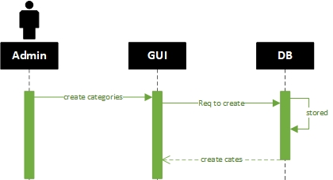
Sequence Diagrams
Admin Create Category
.

Slide 18
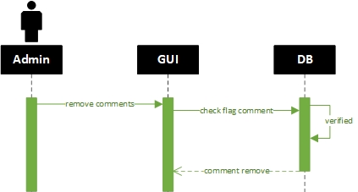
Sequence Diagrams
Admin Remove Comments
.

Slide 19

Sequence Diagrams
Admin Create Tags
.

Slide 20
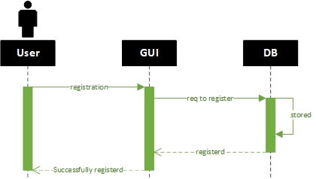
Sequence Diagrams
User Register
.

Slide 21

Sequence Diagrams
User Login
.

Slide 22

Sequence Diagrams
User Create Post
.

Slide 23
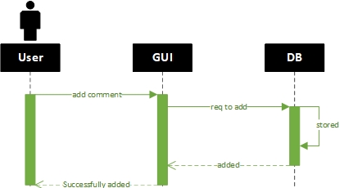
Sequence Diagrams
User Add Comments
.

Slide 24

Sequence Diagrams
User Add Vote
.

Slide 25

Sequence Diagrams
User Search Post

Slide 26
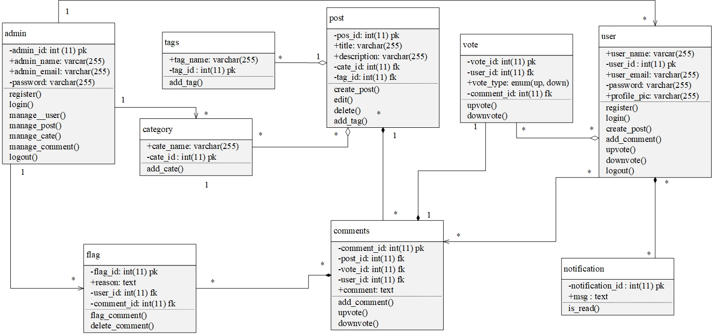
Logical Model/Class Diagram

Slide 27
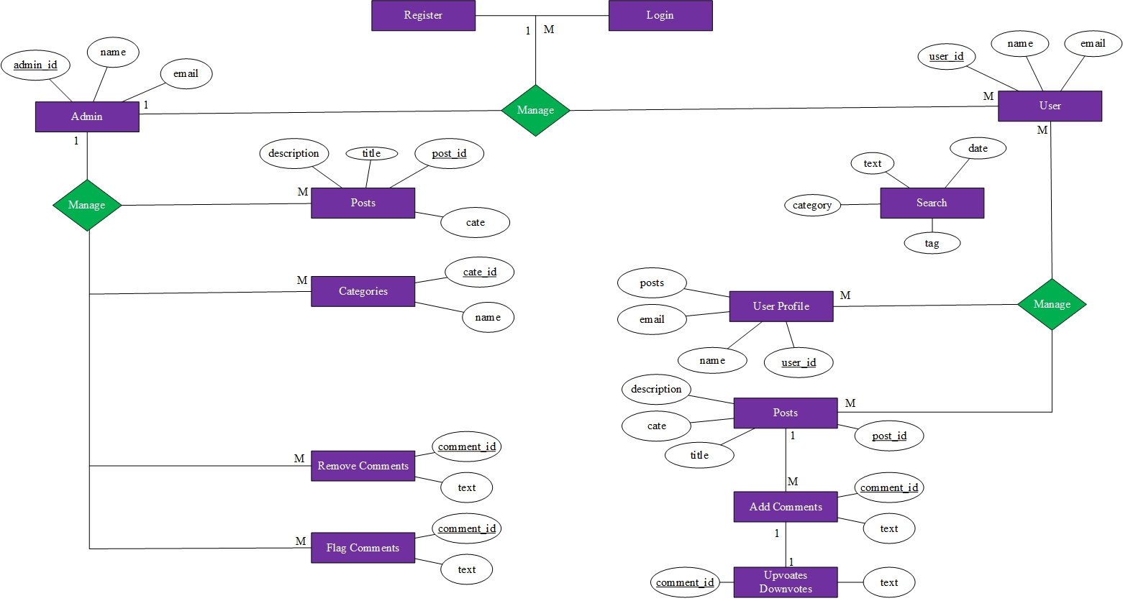
Entity-Relationship Diagram

Slide 28
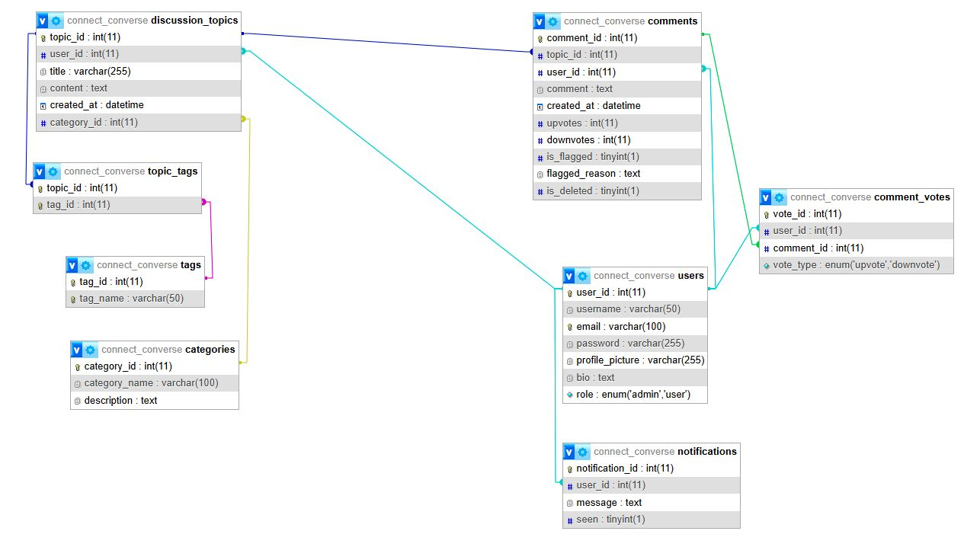
Database Diagram

Slide 29
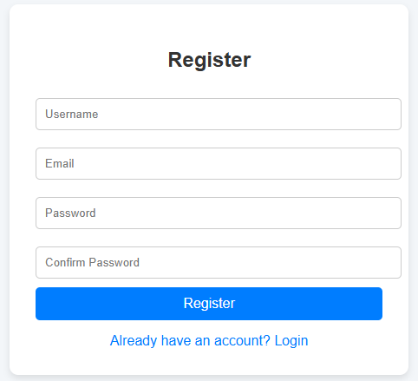
User Interfaces

Slide 30
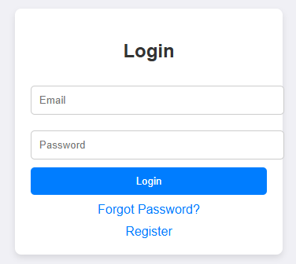
User Interfaces

Slide 31
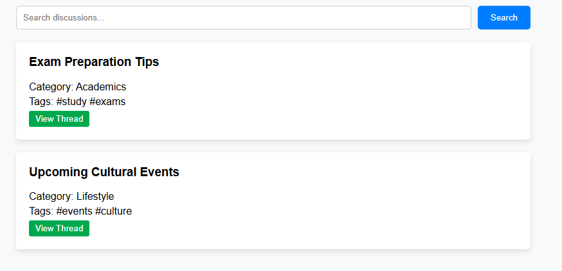
User Interfaces

Slide 32
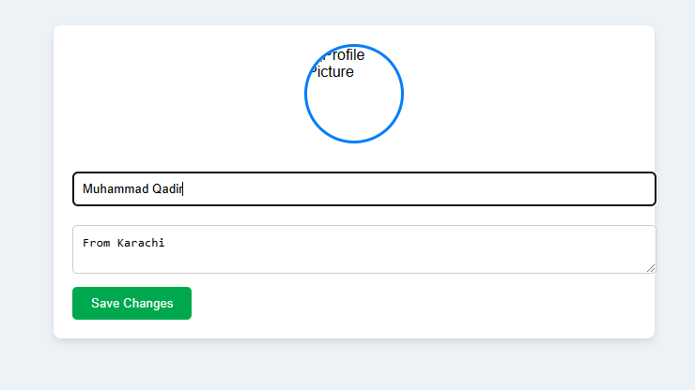
User Interfaces

Slide 33
Tools
Languages: Django, HTML, CSS, JS, BOOTSTRAP
Database Tool: My SQL (Xampp Server)
Other Tools: Microsoft Office (Word, Visio, PowerPoint, MS Project) + VS Code

Slide 34
THANKS

